Slide 1
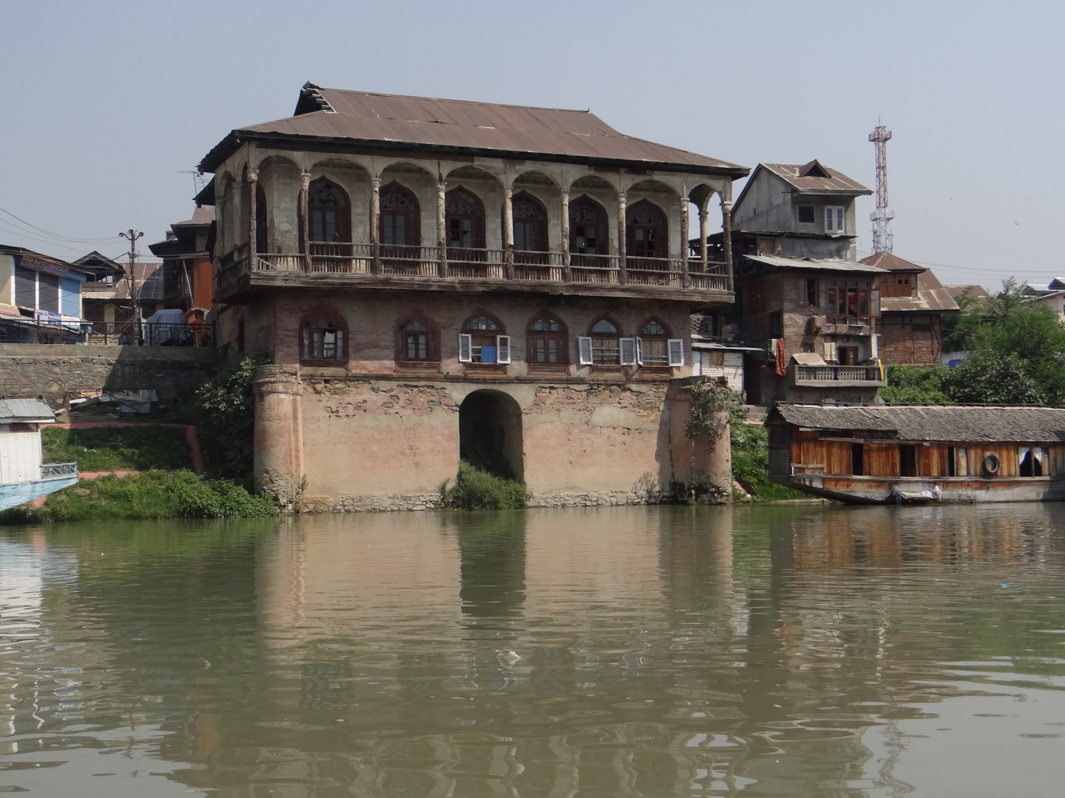
Preservation of Heritage Buildings/Areas
Heritage Building, Heritage
Precincts and Natural Features
SRINAGAR MUNICIPAL CORPORATION

Slide 2
Existing provisions in Municipal Bye Laws 2011
No development and redevelopment
or Engineering operations
or additions, repairs, renovations,
including painting of building,
replacement of special features
or plastering or demolition of any part thereof of the heritage buildings or listed precincts or natural features,
shall be allowed except with the prior permission of the
Heritage Conservation Authority,
SRINAGAR MUNICIPAL CORPORATION

Slide 3
Existing provisions in Municipal Bye Laws 2011
on the basis of recommendation of heritage committee or Archaeological department/s
or any other department/s involved in preservation and conservation of heritage buildings.
The Authority may grant permission for repairs, restorations of these heritage buildings, heritage precincts.
SRINAGAR MUNICIPAL CORPORATION

Slide 4
Suggested amendments in existing Buildings Bye Laws.
“Heritage building”
means any building or any façade which requires conservation/preservation.
“Heritage Precinct”
means any space that requires conservation / preservation.
“Conservation’
means all the processes of looking after a place so as to retain its historical / architectural/ aesthetic / cultural significance.
SRINAGAR MUNICIPAL CORPORATION

Slide 5
Suggested amendments in existing Buildings Bye Laws.
Preservation
means maintaining the fabric of a place in its existing state and retarding deterioration.
means returning the existing fabric.
means returning a place as nearly as possible to a known earlier state and distinguished by the introduction of materials (new or old) into the fabric.
Restoration
Reconstruction
SRINAGAR MUNICIPAL CORPORATION

Slide 6
RESPONSIBILITY OF THE OWNERS OF HERITAGE BUILDINGS
It shall be the duty of the owners of heritage buildings and buildings in heritage precincts or in heritage streets to carry out regular repairs and maintenance of the buildings.
.
The government, the Municipal Corporation of Srinagar or the Local Bodies and Authorities concerned shall not be responsible for such repair and maintenance except for the buildings owned by the Government, the Municipal Corporation of Srinagar or the other local bodies.
SRINAGAR MUNICIPAL CORPORATION

Slide 7
RESTRICTIONS ON DEVELOPMENT/ RE-DEVELOPMENT /REPAIRS.
No development or redevelopment including painting of the building, replacement of special features or plastering or demolition of any part thereof of the said listed buildings / precincts / natural feature areas shall be allowed.
After obtaining permission of commissioner, Municipal Corporation under the advice of the Heritage Conservation Committee to be constituted by the Government
SRINAGAR MUNICIPAL CORPORATION

Slide 8
HERITAGE PRECINCTS/ NATURAL FEATURE AREAS.
In case of streets, precincts, development permissions shall be granted in accordance with the special separate regulation prescribed for respective streets, precincts shall be framed by the Commissioner Municipal Corporation Srinagar on the advice of the Heritage Conservation Committee.
ROAD WIDENING
Widening of the existing roads shall be carried out considering the existing heritage buildings.
SRINAGAR MUNICIPAL CORPORATION

Slide 9
INCENTIVE USES FOR HERITAGE BUILDINGS.
In cases of buildings located in non-commercial use zones the owner/owners with the approval of the Heritage Conservation Committee within permissible use zone to convert part or whole thereof such a heritage building to commercial /office use/hotel.
SRINAGAR MUNICIPAL CORPORATION

Slide 10
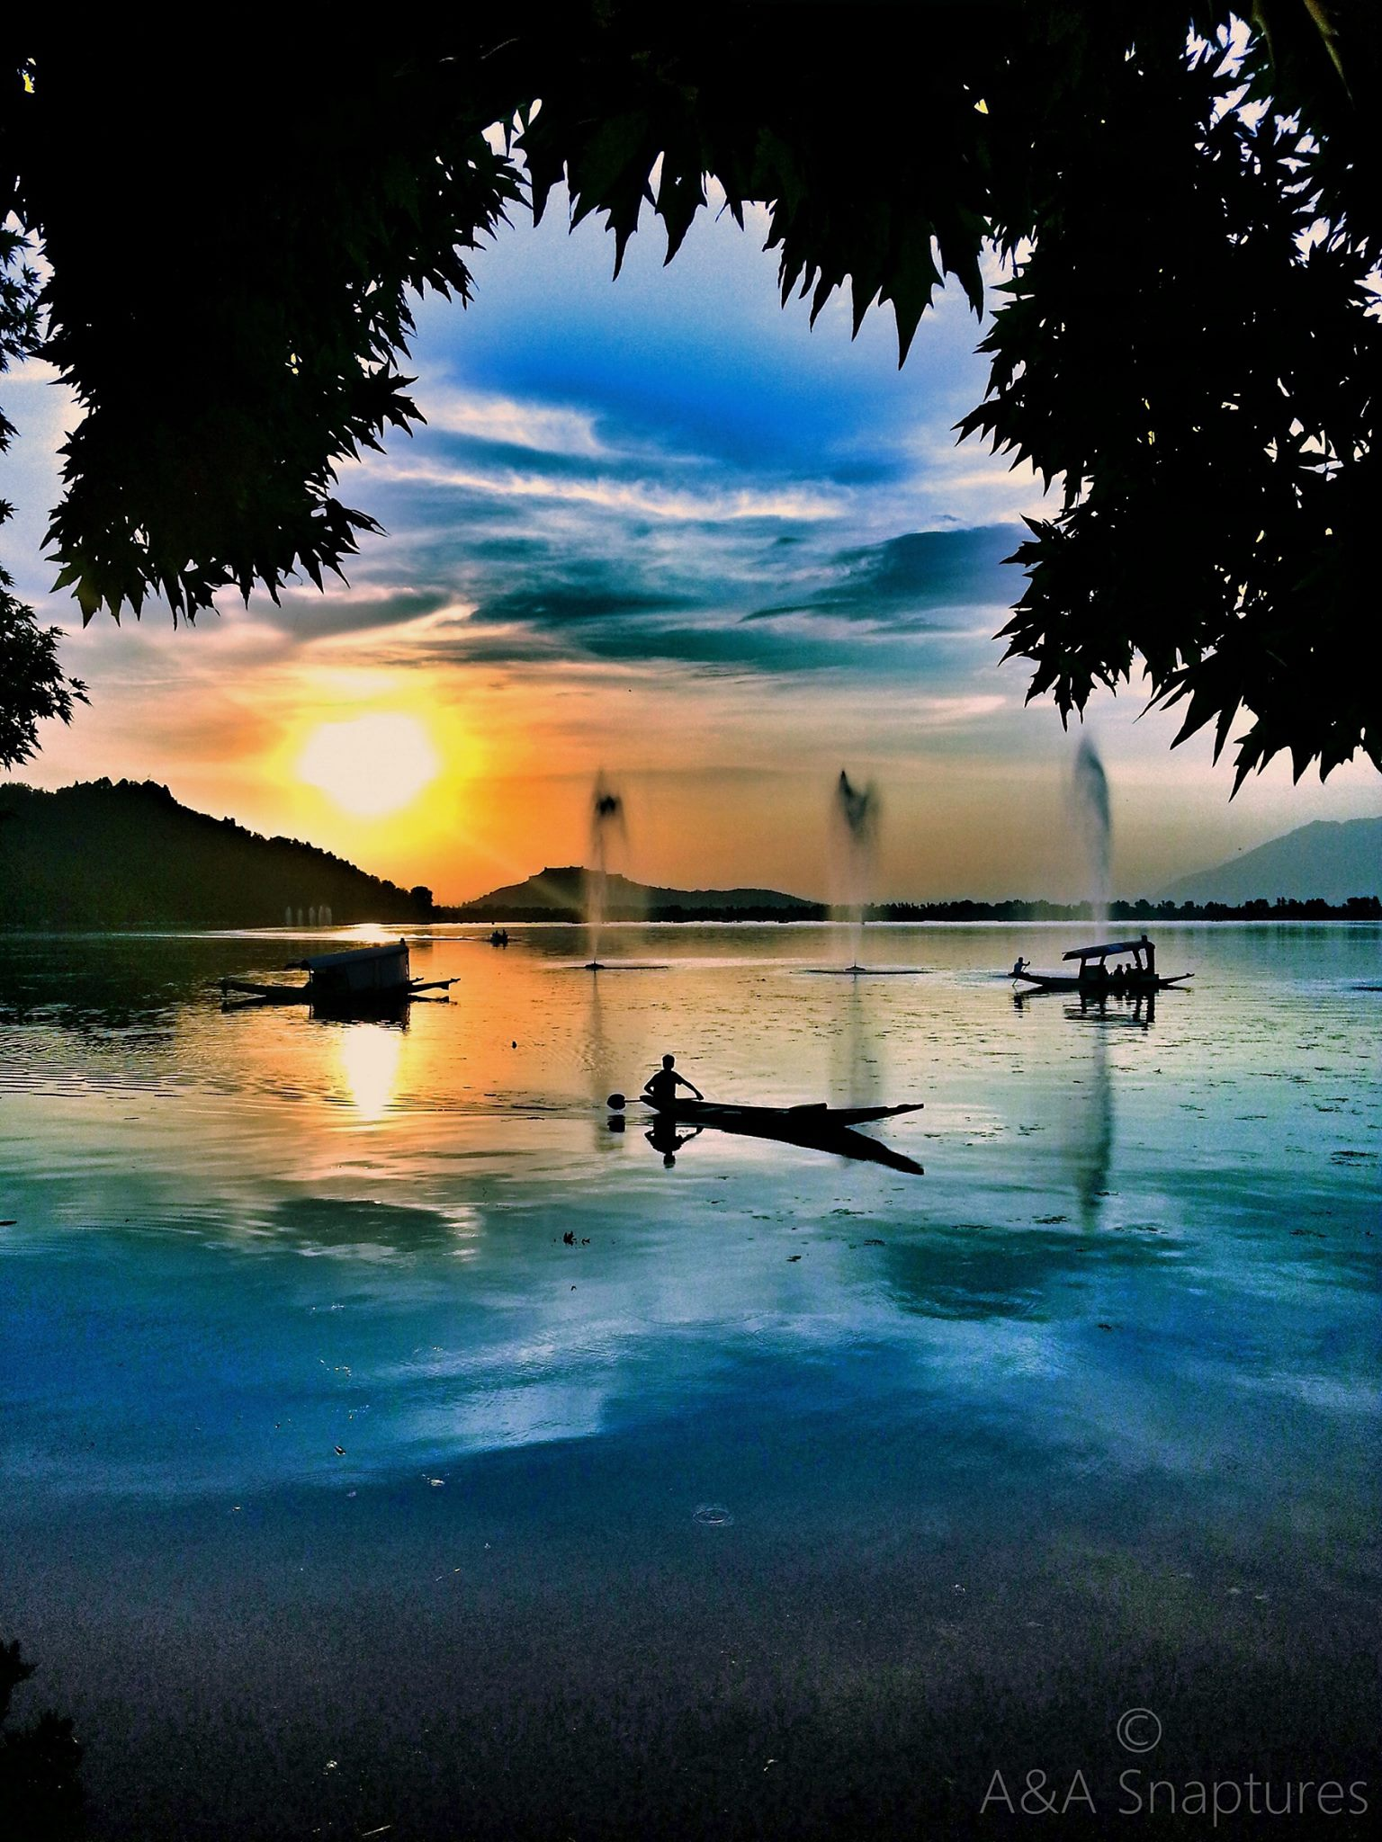
THANKS
SRINAGAR MUNICIPAL CORPORATION

